Slide 1
Optimizing GNN to Solve Community Detection in Social Networks
Abdulmoumen Al-Atrash | Parsa Kamalipour | Aniket Roy

Slide 2
TABLE OF CONTENTS
01.
02.
PURPOSE STATEMENTS
METHODOLOGY
03.
04.
Results
CONCLUSIONS
Introduction and Related Work
Trying GNN and Exploring Modifications
Results Looking Good!
What did we achieve?

Slide 3
01.
PURPOSE STATEMENTS
Community Detection definition and literature

Slide 4

INTRODUCTION
Community Detection:
Definition: Identifying clusters (communities) in a network where nodes are more densely connected internally than with the rest of the network.
Applications: Social network analysis, biology, and information retrieval, etc.

Slide 5
Major Challenges & Problems
1
2
Scalability issues in handling large-scale networks.
Limitations in detecting detailed community structures with traditional methods.

Slide 6
Related Work
Optimization Methods
Modularity-Based Methods
Deep Learning Methods
Our Goal: Leverage GNNs to tackle community detection while addressing the shortcomings of existing machine learning approaches.
Techniques like Learning-Based Genetic Algorithms (LGA) and Quantum-Inspired Optimization achieve impressive accuracy but face challenges in scaling across diverse network types.
Known for simplicity and interpretability. However, these methods rely heavily on modularity maximization, which often limits accuracy in detecting varying community structures.
Advanced models, such as Graph Neural Networks (GNNs), excel at capturing complex relationships but can be computationally demanding for large-scale networks.

Slide 7
02.
METHODOLOGY
Trying GNN and Exploring Modifications

Slide 8
Neighbor Sampling
Approach: Sample a fixed number of neighbors for each node during training.
Benefits:
Reduces computational overhead.
Enables training on larger graphs that cannot fit entirely in memory.
Introduces stochasticity, helping prevent overfitting.
Subgraph Partitioning
Approach: Divide the large graph into smaller, manageable subgraphs (clusters).
Benefits:
Facilitates parallel processing of subgraphs.
Decreases memory requirements during training.
Preserves local graph structures within clusters.

Slide 9
Efficient Graph Convolutions - GraphSAGE (Graph Sample and Aggregate)
Approach: Aggregates feature information from a sampled set of neighbors.
Benefits:
Inductive Capability: Generalizes to unseen nodes or graphs.
Efficiency: Limits neighborhood size, preventing computational explosion.
Applicability: Suitable for dynamic graphs where nodes/edges change over time.

Slide 10
Datasets Utilized for Evaluation
Stochastic Block Models (SBM)
Purpose: Synthetic benchmark for community detection.
Configuration:
Nodes: 1,000
Communities: 4
Intra-community Edge Probability (p_intra): 0.05
Inter-community Edge Probability (p_inter): 0.005
Features: 16-dimensional random vectors
Advantages: Controlled environment to assess baseline performance and scalability.
CORA Dataset
Description: Real-world citation network.
Nodes: 2,708 scientific publications.
Edges: 5,429 citation links.
Features: 1,433-dimensional bag-of-words vectors.
Classes: 7 research topics.
Significance: Represents complex, large-scale networks with inherent noise and irregular patterns.

Slide 11
03.
Results
Results Looking Good!

Slide 12
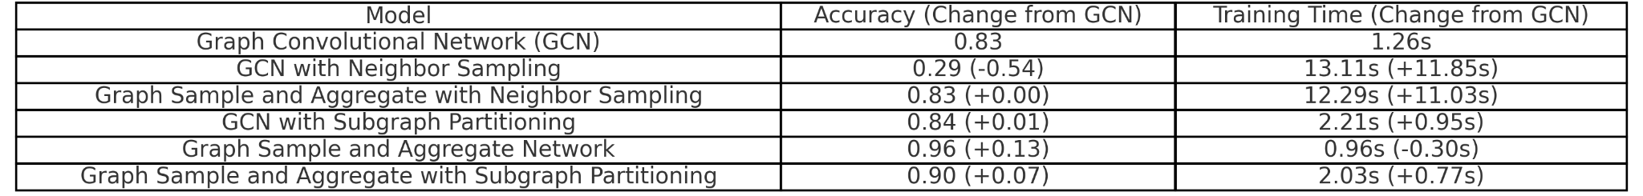
Comparison on SBM
Observation:
Accuracy: The Graph Sample and Aggregate Network achieves the highest accuracy (+0.13) compared to GCN.
Training Time: GCN is faster than most models, except the Graph Sample and Aggregate Network, which is the fastest.

Slide 13
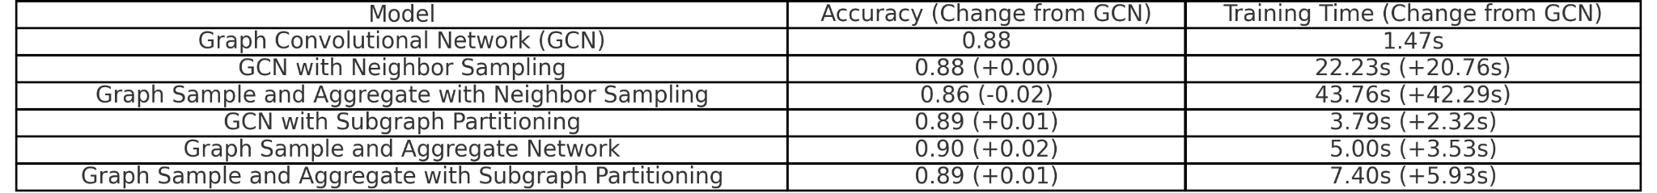
Comparison on CORA
Observation:
Accuracy: The Graph Sample and Aggregate Network achieves slightly higher accuracy (+0.02).
Training Time: GCN remains the most efficient in training time, with Neighbor Sampling and Subgraph methods being significantly slower.

Slide 14
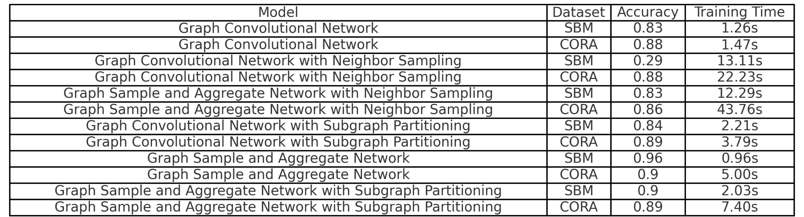
Complete Table

Slide 15
Key Takeaways
1. Best Accuracy:
SBM: Graph Sample and Aggregate Network (0.96)
CORA: Graph Sample and Aggregate Network (0.90)
2. Fastest Training:
SBM: Graph Sample and Aggregate Network (0.96s)
CORA: Graph Convolutional Network (1.47s)
3. Trade-Offs:
Neighbor Sampling methods generally increase training time without significantly improving accuracy.
Subgraph Partitioning adds some overhead but improves accuracy and training efficiency.

Slide 16
Key Takeaways for SBM and CORA
1. GCN Strengths:
Maintains competitive accuracy.
Very efficient in training time.
2. Graph Sample and Aggregate:
On SBM, it outperforms all models in accuracy and training speed.
On CORA, it achieves the best accuracy but takes slightly longer to train.
3. Neighbor Sampling Methods:
Generally introduce longer training times without significant accuracy improvements.
4. Subgraph Partitioning:
Provides a reasonable balance between accuracy and training time, making it a solid enhancement for both datasets.

Slide 17
04.
CONCLUSIONS
What did we achieve?

Slide 18
Recap
How?
Goal
Why?
Advanced machine learning methods: Graph Neural Network
To overcome the limitations present in traditional community detection approaches
Struggle with generalizability and the ability to adapt to networks of varying sizes and structures

Slide 19
ML increases both accuracy and scalability, which aims at making community detection more useful for large, complex networks.

Slide 20
What Was the benefit of this project?
A chance to understand network structures better and how advanced machine learning models help improve community detection

Slide 21
THANKS!
Hope this presentation was useful to you :D

